Slide 1
Ancient Tools and Weapons

Slide 2
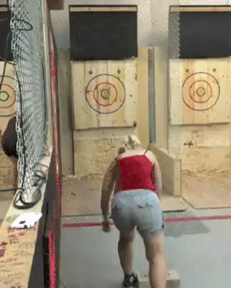
By the end of this lesson you will be able to:
Identify three examples of ancient tools and weapons: the axe, woomera and boomerang.
Describe how these ancient tools and weapons are used.
Describe how these ancient tools and weapons use forces.

Slide 3
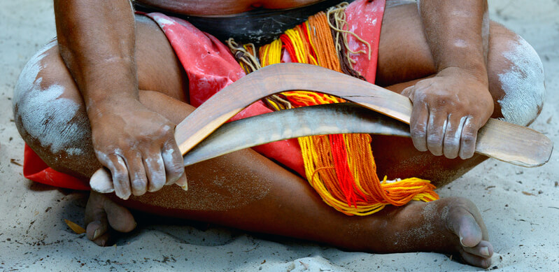
Ancient tools could often be used as weapons, and vice versa!
This lesson will explore the general tools and weapons developed in the Stone Age, along with some specific Indigenous Australian examples.

Slide 4
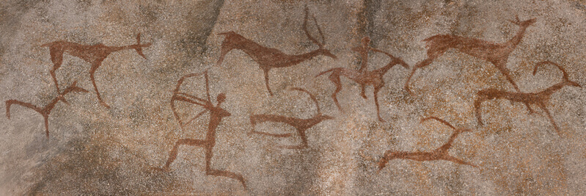
Humans started using simple machines long before we understood how they worked!
The idea of simple machines began with the Greek philosopher Archimedes, over 2000 years ago. He studied simple machines such as levers and began to understand their mechanical advantages.
However, humans have been using simple machines like wheels and inclined planes for much longer than this in the form of ancient tools and weapons. These started to appear in the Stone Age, around four million years ago!

Slide 5
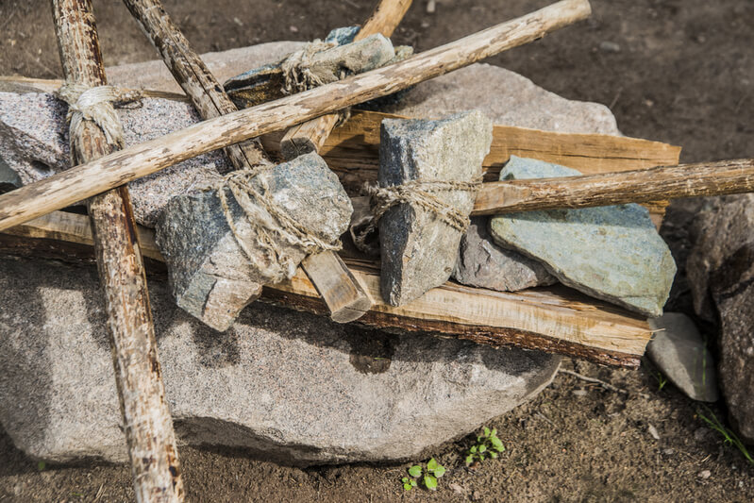
Most ancient tools were some form of rock tied to a stick.
The biggest variety was what material the rock was, and if it was blunt or sharp.

Slide 6
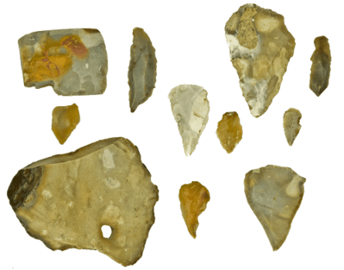
Stone Age tools were produced through a process known as flaking.
A large stone was struck with a hammer (which was usually just a smaller stone) to chip off sharp pieces of stone, called flakes. These flakes were sharp enough to be used for spearheads, knives, axes and chisels.

Slide 7
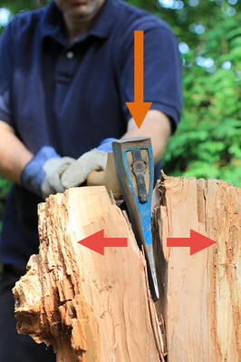
Ancient stone axes work the same way as modern metal axes.
Axes are made up of two inclined planes to make a wedge.
When a large force is applied to a wedge, it produces an outward force that will drive two surfaces apart.
Ancient axes used this mechanical advantage for tasks such as splitting wood, stone or animal hides.

Slide 8
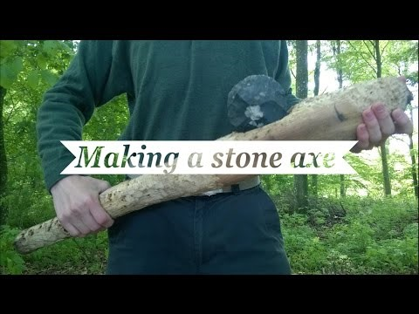

Slide 9
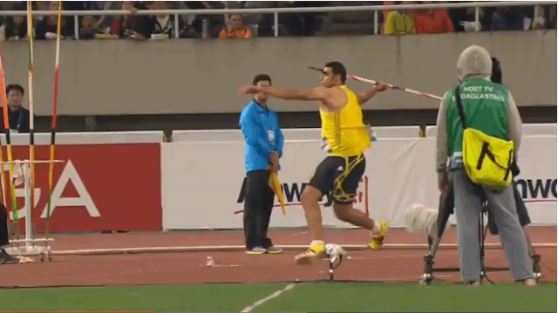
Spears have also been used for a very long time as weapons!
Throwing the javelin in the Olympics is just the same as throwing a spear. The thrower applies a large force to the spear, which flies through the air then applies a similar large force into a target.
The larger the throwing force, the greater the impact.

Slide 10
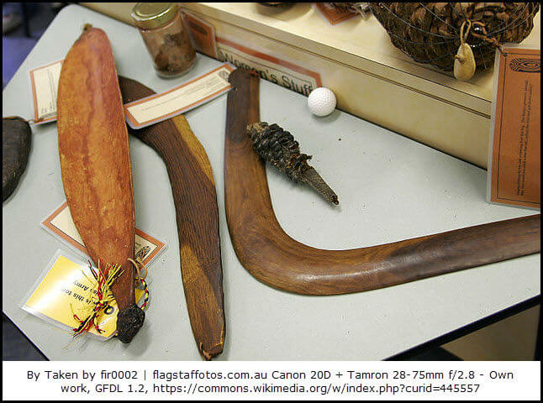
The woomera is an Australian Aboriginal device which increases the force with which a spear can be thrown.
It acts as an extension of the human arm, increasing the leverage as the spear is thrown. A woomera is on the left of the image below.

Slide 11
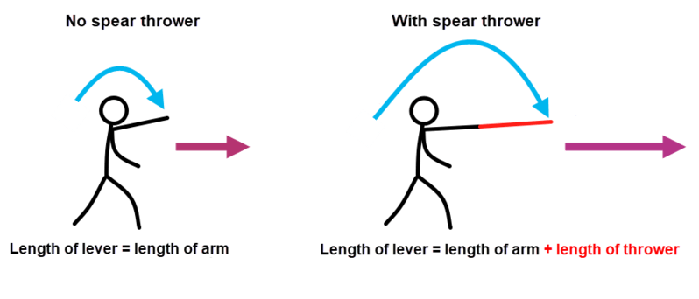
When a spear is thrown, the arm acts as a lever.
Extending the arm increases the length of the lever, which increases the force as it is thrown, allowing it to travel faster and farther.

Slide 12
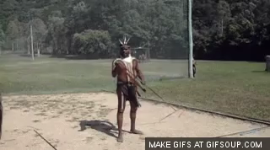
The woomera can extend a person's throwing arm by up to a metre!
The woomera is a curved, half pipe shape that tapers at the ends. They were made using local plant life, such as spinifex grass, which is used to create a wax to attach things to together.
There is a point at one end in which to fit the spear, and a rounded end to use as a handle.
By increasing the length of the lever (a person's arm), force is applied to the spear over a larger distance, which means the same amount of throwing force will move a spear further and faster!

Slide 13
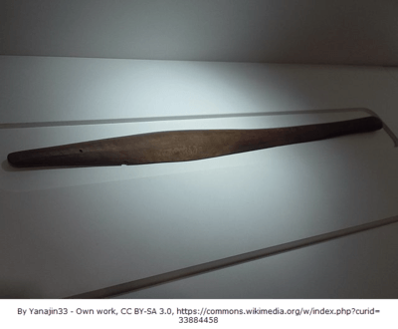
The woomera has more than one use as an ancient tool.
The Australian woomera is very similar to the Aztec atlatl, with one key difference: the woomera is carved with a curved, bowl-like shape that allows it to also carry food and water.

Slide 14
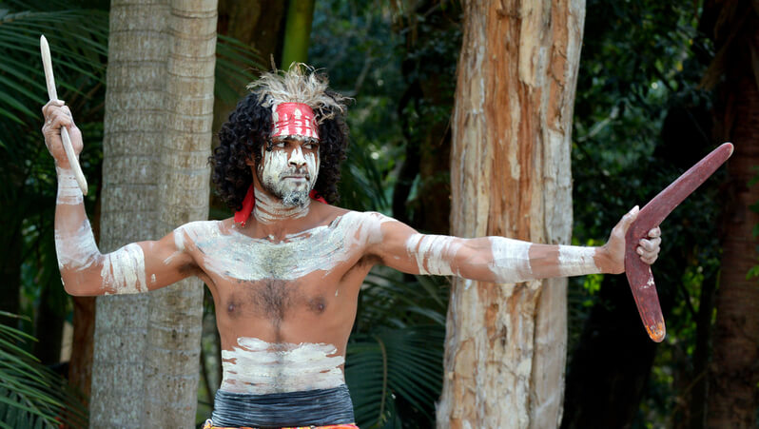
The oldest boomerangs discovered in Australia are 10,000 years old!
Boomerangs were not originally supposed to return! They were designed as precise hunting sticks, and it is suspected that the first returning boomerang was accidentally created by hunters trying to make a throwing stick that flew straight!
A non-returning boomerang was designed to travel in a straight direction with as much force as possible. These were used for hunting or as weapons.
A returning boomerang is the most recognisable form, and are mostly used for recreation. Modern boomerangs come in lots of different shapes!

Slide 15
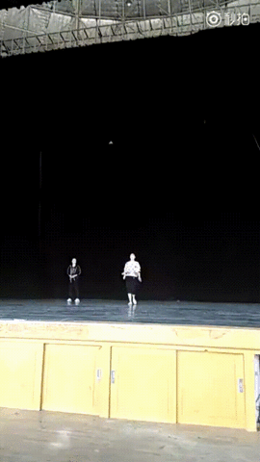
Whether it is flying straight or returning, a successful boomerang needs to be carefully designed.
A well designed boomerang combine aerodynamic lift and its rapid spin to create a precise flight path.
Returning boomerangs involve complex forces and must be thrown in a specific manner in order for them to return.

Slide 16
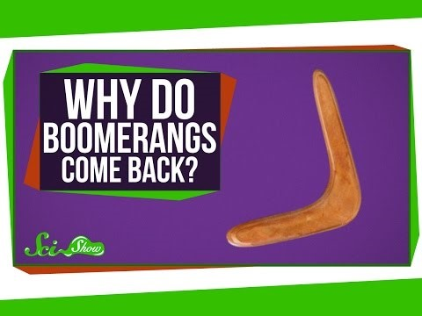

Slide 17
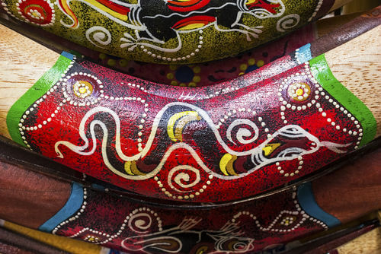
As well as weapons, boomerangs were also designed to be used as tools.
Boomerangs can be used as hand-clubs, musical instruments, fire-starters and tools for digging!

Slide 18
